Slide 1
Artificial Neural Networks (ANN) Multi Layer Perceptron (MLP)
Michael Claudius, Associate Professor, Roskilde

Slide 2
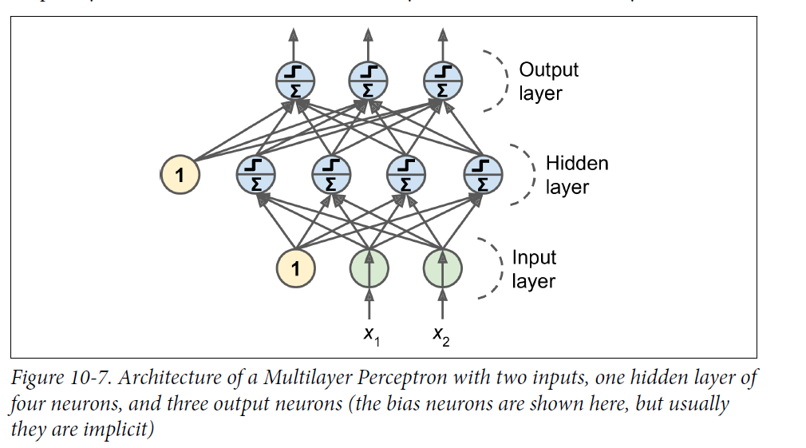
Multilayer Perceptron (MLP)
Perceptron stand alone cannot solve many problems. Also simple binary problems: e.g. A XOR B !
Solution is a layered architecture
Problem: How to train? Don’t worry we have backpropagation since 1986 !

Slide 3
Backpropagation agorithm
Take a mini-batch (typically 32 instance) one at a time
Forward pass (prediction)
Send mini-batch to first layer
Calculate output
Send result to next layer
Finally we have the output in output layer
Calculate the output error (using a loss function)
Backward pass
Measure error gradient on connection weights
Performs Gradient Descent to change all connection weights
Take next mini-batch; Repeat the steps
Pass the training set many times called epochs
Problem: Cannot use activation step function in Gradient Descent, Need another activation function!

Slide 4
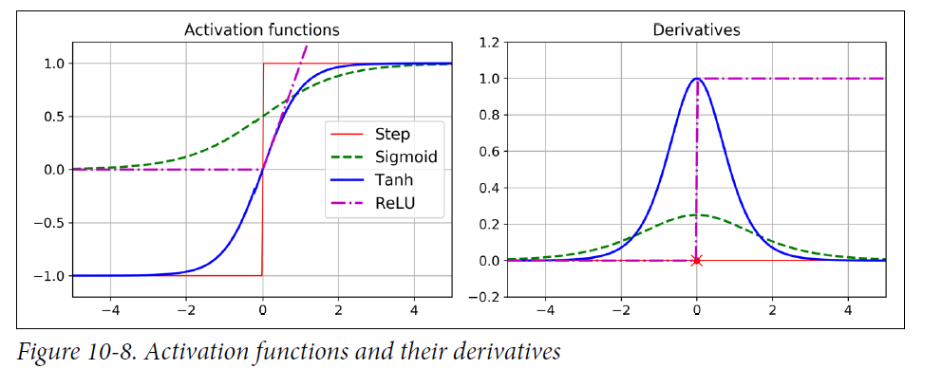
Activation functions
Many types, 3 popular types in use
ReLU: Rectified Linear Units (maybe Softplus version)
Sigmoid, Sigmoid function from logistic regression (classification)
Tanh: Tangent hyperbolic

Slide 5
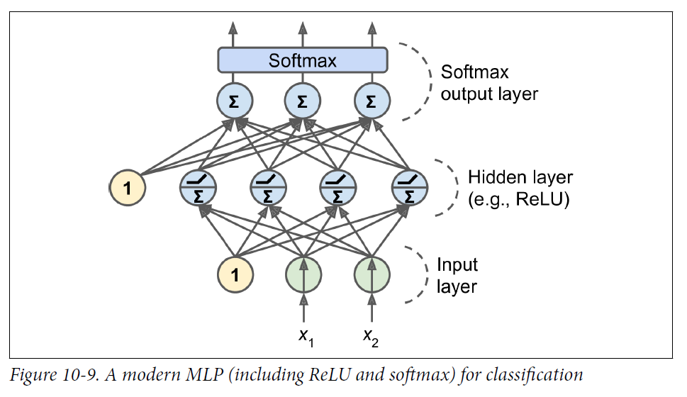
Multilayer Perceptron (MLP): Modern Classification
Input layer with features with bias 1
One or more hidden layers with neurons, bias 1 and using ReLU: Recitfied Linear Units
Output layer with Sigmoid function (probability 0-1) and one neuron per class

Slide 6
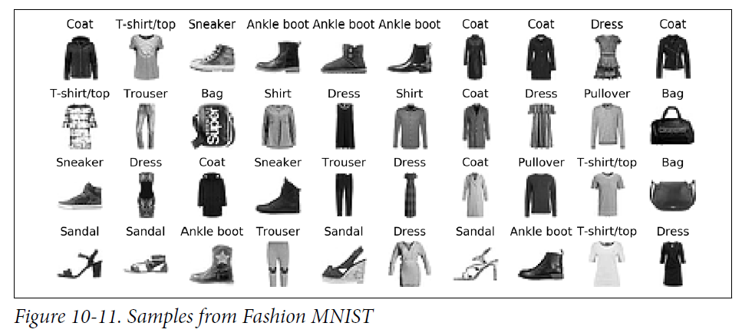
MINST Fashion Dataset
10 classes: sneaker, coat, ….
Feature is a 28x28 pixel picture
70.000 pictures: 60.000 in training set 10.000 test set

Slide 7
Keras model: Sequential Model Code
Load the data
Set up validation set for the epochs
Flatten 2-dimensional matrix (array) to 1-dim array
Create a model with two inner layers and one output layer
Dense all neurons connected to next layer’s neurons
Now let’s look at the whole program code

Slide 8
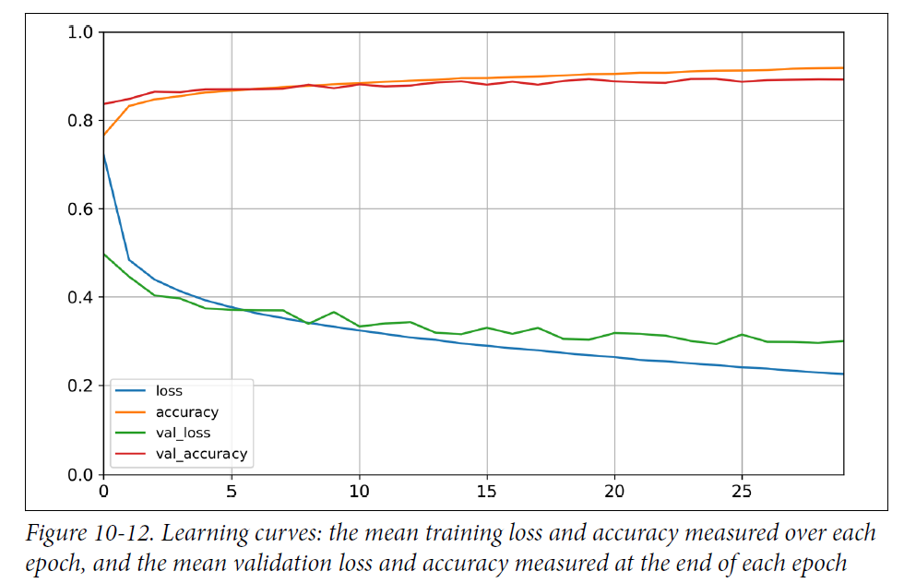
Learning curves: Accuracy and loss
Accuracy: percentage correct
Loss: Cross-Entropy (Chapter 4) for classification, MSE for regression

Slide 9
Fine tuning hyperparameters
Number of layers
Number of neurons
Neurons distribution
Activation function
Normally more layers better than many neurons
Neurons more in start than later, Claudius’ favourite: 200, 50, 50 10
ReLU is standard but you never know !

Slide 10
Code and Assignment!
First a small round tour in the code,
Then more assignments
Later at home, MAYBE relax with a video or two

Slide 11
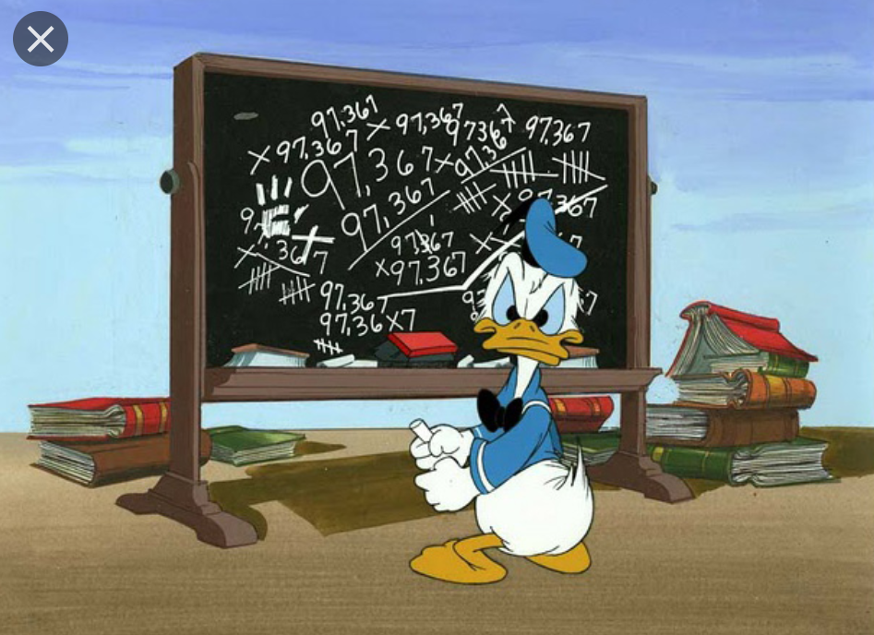
Assignments second round
It is time for discussion and solving a few exercises in groups
MLP Classfication Fashion Exercise
Playground at tensorflow.org

